Slide 1
C4D Network Challenge 2016

Slide 2
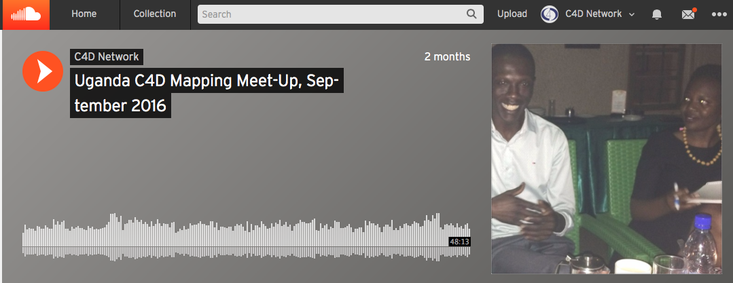
Uganda, September 2016

Slide 3
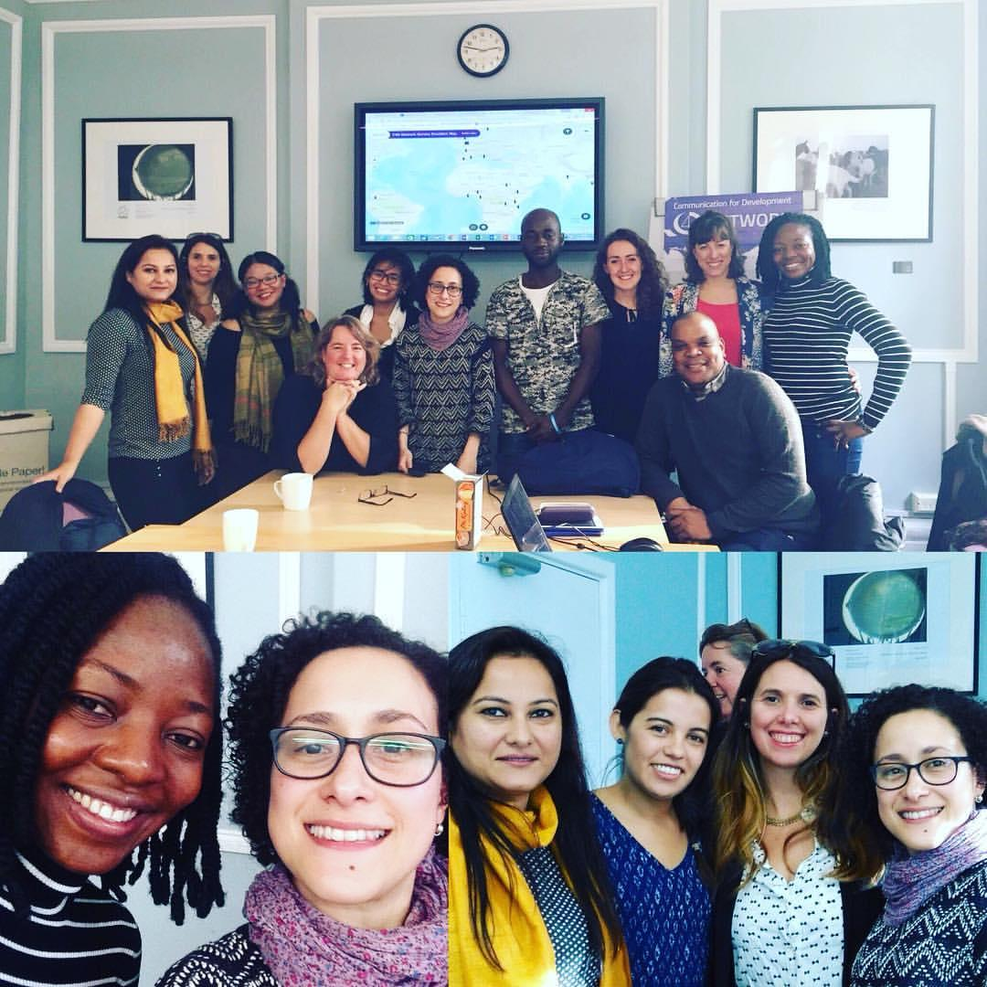
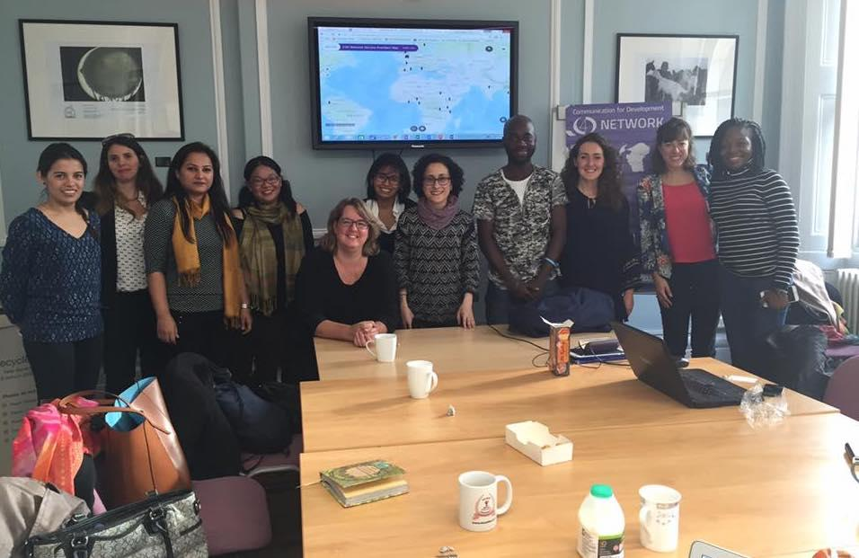
UK, October 2016

Slide 4
Kenya, November 2016
“The event tonight was excellent. Working in the development field, it was refreshing to hear ideologies, perspectives and action plans.” - Adrian, C4D Network member

Slide 5
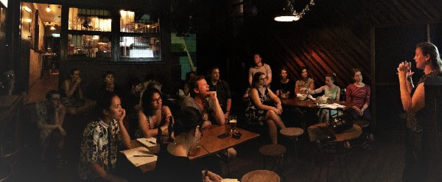
Australia, November 2016

Slide 6
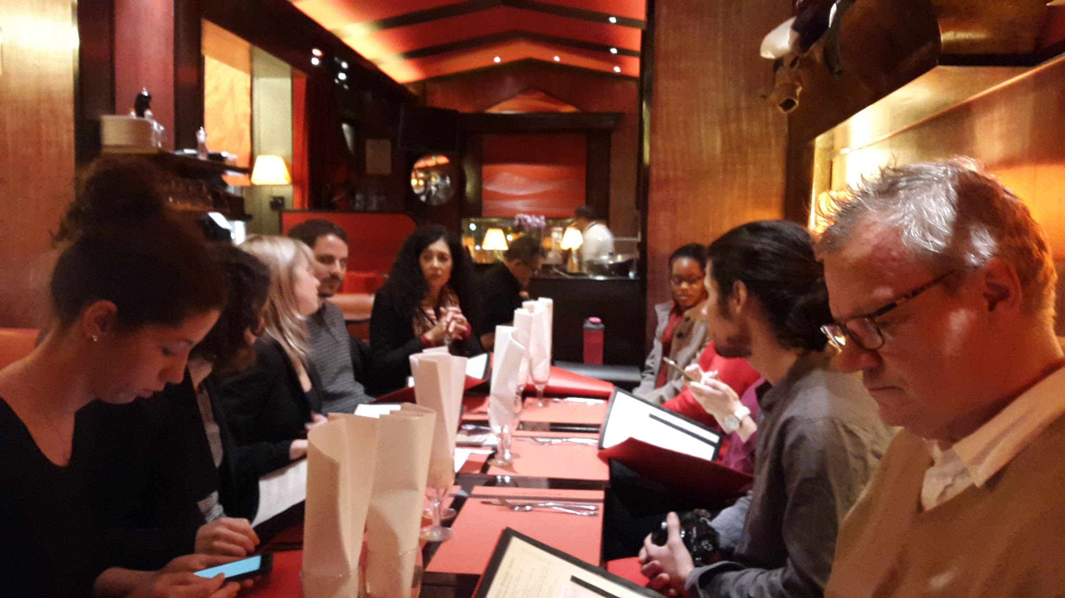
France, November 2016

Slide 7
MENA, December 2016
“For me, it was one of the greatest experiences to be part of the discussion” - Angelo, C4D Network member

Slide 8
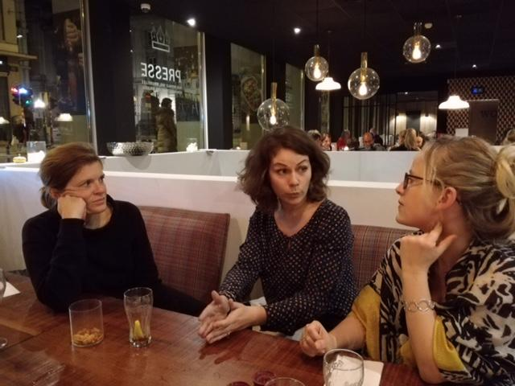
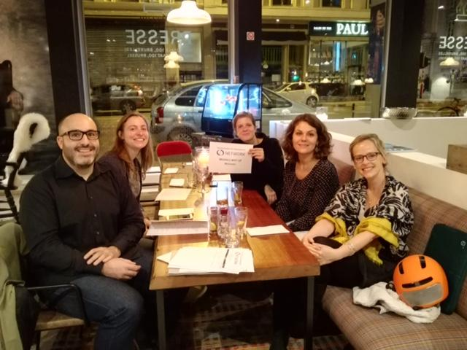
Belgium, December 2016

Slide 9
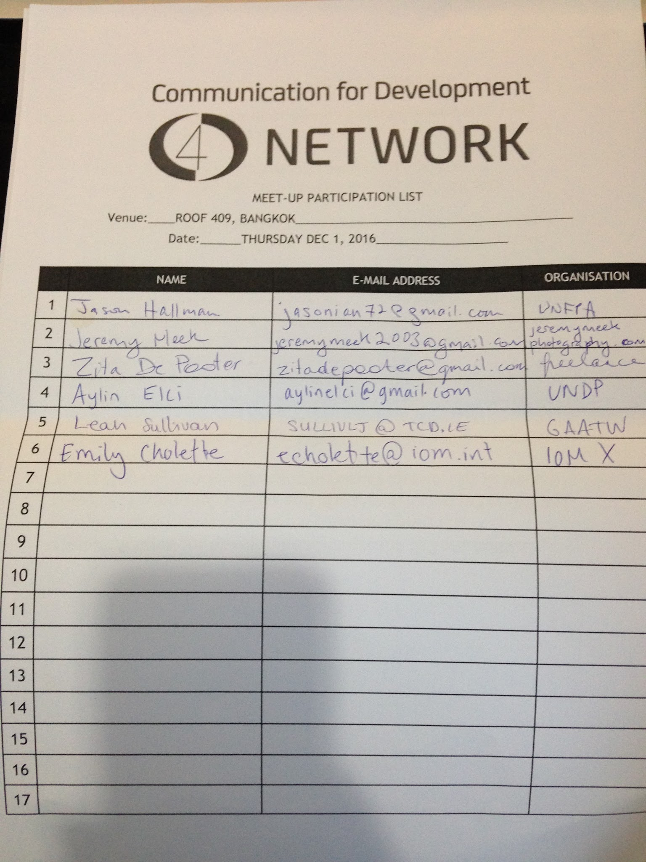
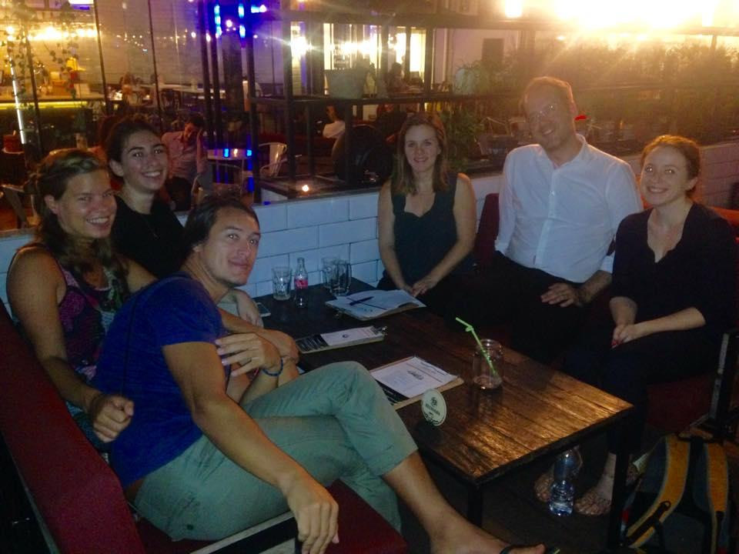
Thailand, December 2016

Slide 10
Papua New Guinea, December 2016
“We (my section and our managing contractor) feel that this discussion will not just fulfil the challenge but provide us an opportunity to understand the C4D story for PNG as we proceed to designing a C4D strategy for our program” - Junita, C4D Network member

Slide 11
Zimbabwe, December 2016

