Slide 1
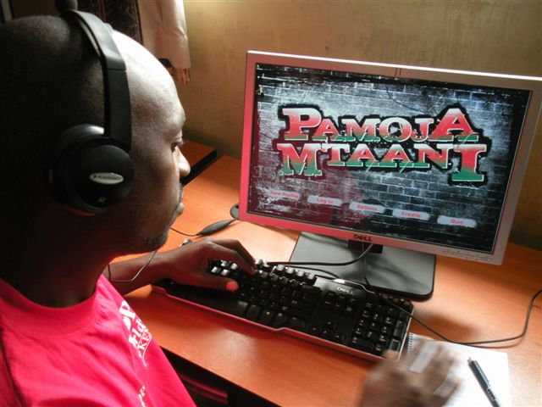
Pamoja Mtaani ‘Together in the Hood’
The objective: HIV Prevention among Kenyan youth
The intervention: PC-based multi-player videogame
Played in youth centres
Language: Sheng
The challenge: to integrate BC elements without compromising player engagement
Notes:
HIV in Kenya:
Pamoja Mtaani, Swahili for “Together in the Hood,” combines fun 3D multiplayer game play with messaging aimed at changing behaviors that can reduce HIV infections among youth.

Slide 2
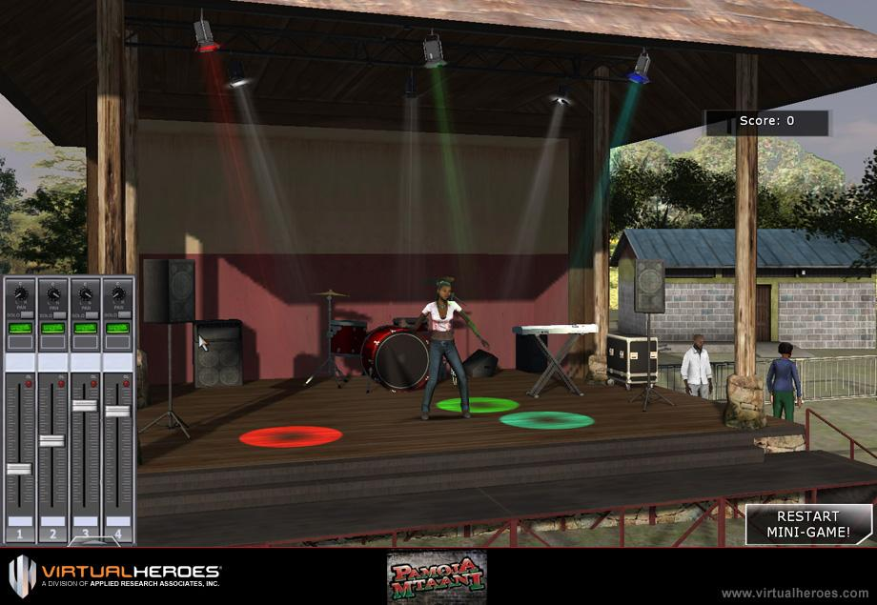
Stakeholders
PEPFAR - OGAC/CDC – public partner
Warner Bros – private partner
Virtual Heroes- game developers
Local scriptwriter and advisors
Behaviour change expert - me
Audience members – youth organisations
Intel - computers
Youth centres
Evaluators - Prevention Science Consulting, LLC and Impact RDO
Notes:
Office of the Global AIDS Coordinator and the US Centers for Disease Control and Prevention
Virtual Heroes, Warner Bros. and PEPFAR (U.S. President’s Emergency Plan for AIDS Relief) partnered to deliver a targeted HIV prevention message to East African youth in Kenya.
Process was participatory, involving a range of stakeholders

Slide 3
Notes:
The Game opens with characters on a matatu (minibus) which is carjacked by 3 assailants resulting in the driver being killed and a young female passenger being assaulted. The 5 player characters all have an item of importance that they will need to retrieve and this and finding medical assistance and justice for the young girl provides the impetus for gameplay throughout. The scenario is situated in the slum where they will meet the clairvoyant Mama Africa character who will help guide them to clues about the whereabouts of their possessions and ultimately to avoid a disaster.
At the beginning of _Pamoja Mtaani each of the five playable characters practice a specific risky behavior that makes them more susceptible to contracting or spreading HIV. Throughout the course of gameplay, and reinforced through cinematics and in-game interactions, each character comes to realize the risks that they have been taking and the proper steps with which to avoid them

Slide 4
How did we meet the BC challenge?
Adapted an approach developed by CDC called MARCH – Modelling and Reinforcement to Combat HIV/AIDS - used for HIV communication programmes under PEPFAR in several countries in Africa
Modelling component: Set five behavioural journeys for the five characters to follow e.g. delay sexual debut, reduce sexual partners, use condoms correctly and consistently; get tested for HIV
Theory-informed: Stages of Change, Social cognitive theory and Socio-ecological model
Research-based: identified factors influencing these behaviours among Kenyan youth
Environmental, social and personal factors - barriers and facilitators
Character profiles: each one had to role model movement between selected stages of change relating to one of the behavioural objectives
Notes:
“From our initial research, we realized that this game had to take a different approach from the conventional HIV/AIDS awareness didactic approach. We knew that the youth would resist an ‘in your face’ educational game, but we also wanted to avoid a simplified game that rewarded players for choosing the correct path to avoid ‘risky behaviors,’ because we felt that the youth would only make those decisions because the game would reward them for doing so, not because of any actual behavioral change within the player. Instead, we incorporated a ‘stealth learning’ approach that is concentrated within the game’s cinematics and character interactions.
Stages of Change: Prochaska Transtheoretical Model of change has been the basis for developing effective interventions to promote health behavior change. The model describes how people modify a problem behaviour or acquire a positive behaviour.
Social learning/social cognitive theory: Bandura – influence of role models on an individual’s behaviour. Role models can do several things. They can educate by providing basic information on how to change and by modeling the steps. They can also persuade and motivate by altering perceptions of the costs and benefits of changing behaviour, and building self-efficacy by providing information for social comparison – ‘if he can do that so can I’
Socio-ecological model: looked at the range of influences on each behaviour amongst young urban Kenyans –
Research done by CDC and verified with focus group discussions amongst young people representative of the target audience

Slide 5
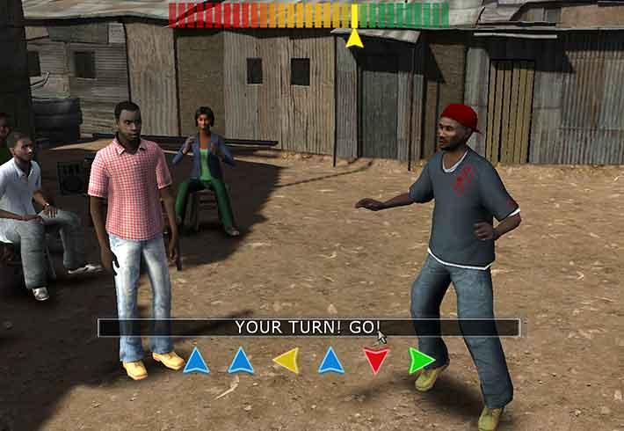
How did we integrate BC elements in the game?
Authenticity of the game: Virtual Heroes took 1000s of photos in areas of Nairobi to create the open-world multi-player environment
Game play opportunities: scenarios, settings, side missions, player and non-player character interactions
Structured tools: these laid out what Evidence of Role Modelling the writer and game developers should show through ACTION or SPEECH or SETTING
Notes:
Players can select to be one of five characters. Initially each one is modeling a risky behaviour relating to HIV. Challenge to integrate behaviour change elements in a minimal and
unobtrusive way so as not to detract from the entertainment value of the game. Videogames contain relatively little dialogue so it had to work very hard!
To ensure the game connected with Kenyan youth, team members from Virtual Heroes and WBIE traveled to Kenya to get a better understanding of the culture that plays a larger role in the serious game. According to the game's designer at Virtual Heroes, Pamoja Mtaani consists of four large and unique environments based upon the different socio-economic localities of Nairobi, Kenya. The localities (Chini Ya Maji, Ulamini, Jijini, and an open-air Youth Festival) were designed using extensive in-country research with the ultimate goal of creating a truly immersive and culturally accurate living world.
A team of 25 people spent 10 months working on the game. Under normal circumstances, a game of this size generally takes two years to develop from scratch
We ended up producing an open-world, multi-player environment with four large, distinct outdoor areas, several hundreds of interactive NPCs and a few dozen vehicles, resulting in a total of almost ten thousand game objects, all being processed simultaneously on the game server,
Used the game play opportunities for player and non-player characters to model risk behaviours as well as barriers and facilitators to behaviour change; constructed the virtual reality to show risk settings such as bars, as well as supportive settings such as clinic, job centre, condom machine

Slide 6
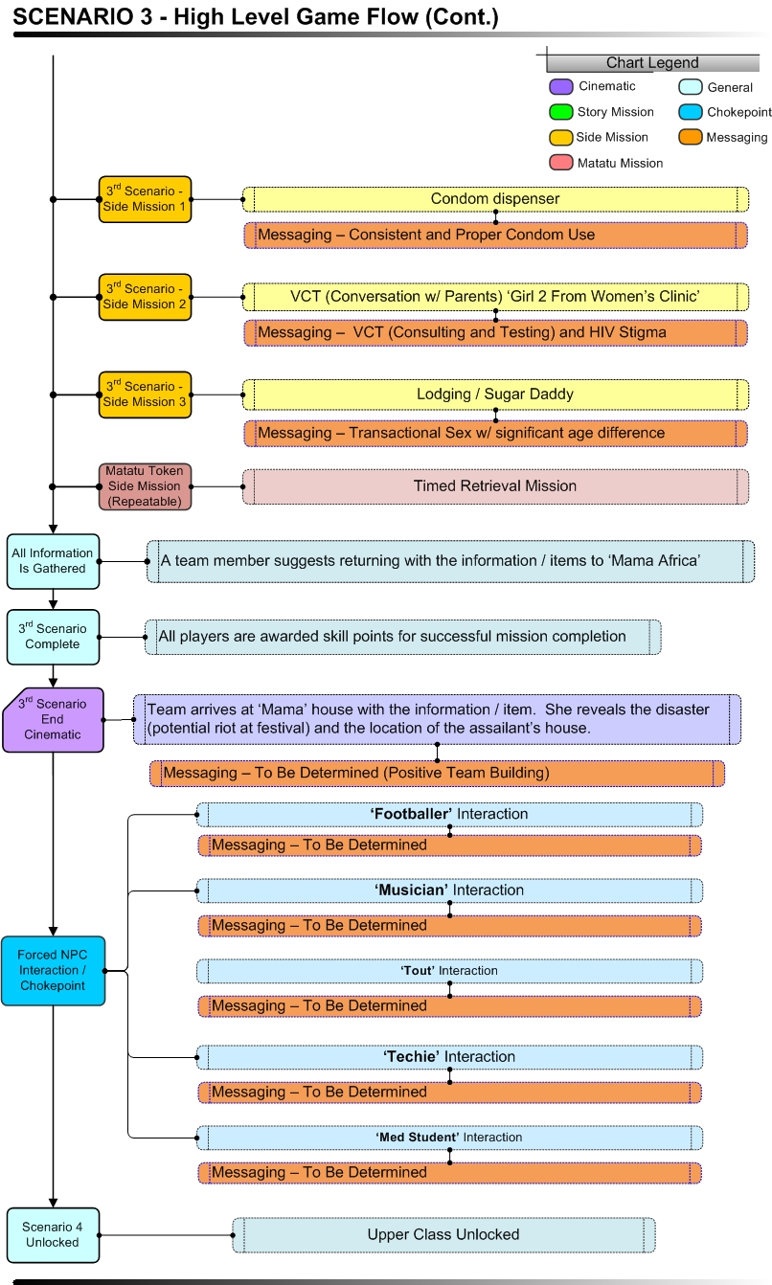

Slide 7
Georgy the matatu tout
Risk behaviour: engages in multiple transactional sexual partnerships
Stages of change: to move from not being aware or denying risk of multiple partners and transactional sex (Precontemplation) to acknowledging the risk to himself and potential partners (Contemplation)

Slide 8
Georgy the matatu tout
Key barriers
Low risk perception e.g. thinks its cool to sleep with many girls; Believes young girls don’t pose any risk;
Low self-efficacy: Has a fatalistic attitude to death; thinks he has no options
Social norms: Its acceptable among his peers to have many, and very young partners; Its expected that touts get sex in return for giving free rides to girls;
Environmental: His job puts him in a situation where he meets lots of women, and some of them are in a position of powerlessness; exposed to macho, ‘dog eat dog’ culture, and risk settings such as bars
Key facilitators
Emotional engagement: The rape of the young girl he just hit on moves him to sympathise with her and want to distance himself from the rapist and that kind of behaviour; Put in situations where he becomes protective of women/girls
New skills: During course of game, starts thinking about others, working as a team, using his communication skills to benefit others not just himself
Notes:
E.g. The Tout ‘Georgy’ starts off as a selfish ‘player’ who has multiple younger girlfriends many of whom he chats up on the matatu, in the expectation of sex in return for giving them free rides (transactional sex). This is a norm for his peer group
We felt it would be unrealistic for Georgy to become a completely reformed character in the story arc of the game. Instead he models FIRST STEPS in behavioural change that take him from the Pre-contemplative stage to the Contemplative stage.
Initially he is not thinking about change and flaunts his success with girls. Through the experience of being carjacked and having to work as a team to help the Non Player Character Adelia – who is assaulted by the carjackers - and his interactions with the other characters who are more gender sensitive, he starts realising the impact of his behaviour and he starts distancing himself from it.
By the end of the game he starts thinking and reflecting on his behaviour, seeing the relevance of information (about HIV) to himself and acknowledging risk factors to himself (dating many partners) and his partners (dating young girls; giving free rides in exchange for sex) in his life.

Slide 9
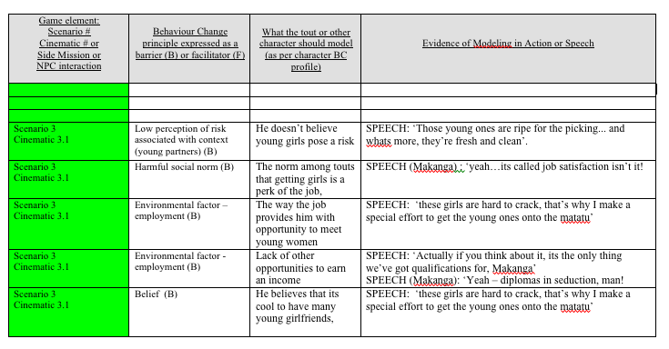
Georgy the matatu tout
Notes:
Example of tool developed to guide scriptwriter and game developers; content created jointly and always checked with youth focus groups/representatives of target audience.

Slide 10
Evaluation
Pre/post assessment of players – after completing different levels of game play
Players/non-players cross sectional survey
Evaluation measured mediators/predictors of behaviour: risk perception and self-efficacy
Computer administered surveys and computer software data capture assessed exposure to BC elements in the game
Four exposure measures: did not play, played levels 1, 2 and 3
Notes:
The Micro 1 (M1) Computer-Administered Survey:
-Collects sociodemographics completed at pre-game play
-Not administered during subsequent game play visits
The Micro 2 (M2) Computer Software:
-Programmed to capture data assessing videogame exposure -No action is required by youth in the collection of these data
The Micro 3 (M3) Computer-Administered Survey:
-Assesses outcomes of HIV risk (self-efficacy, beliefs, intentions)
-Administered at baseline (pregame exposure)
-Administered as youth complete Level 2, Level 3 and Level 4
Exposure - Measure 1 Did adolescents play the videogame? Measure 2 What level of videogame play did adolescents complete? Measure 3 Number of behavior change communication messages viewed? Measure 4 How much time did adolescents spend playing the videogame ? (cumulative)

Slide 11
Results
Playing the videogame was associated with adolescents:
being more confident that they could reduce their risk of HIV.
believing that engaging in certain HIV prevention practices would reduce their risk of HIV (correct and consistent condom use, reduction of partners)
having a greater intention to reduce their risk of HIV (reduce partners, use condoms)
having a greater utilization of HIV prevention services (VCT, STI)
Game players had higher risk perception and self-efficacy but less likely to self-report safe behaviours than non-game players

Slide 12
Cross-sectional survey

Slide 13
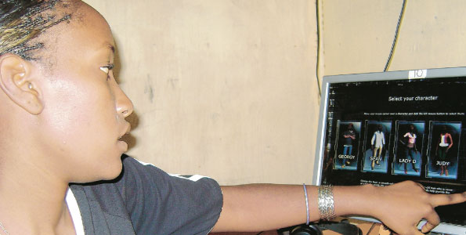
Caroline Wangeci, 20, says ‘the messages in the game such as sugar daddies and use of condoms, abstaining from sex and the importance of being faithful to one’s partner have taught me important lessons in life’

Slide 14
Constraints
Resource intensive intervention – difficult to replicate
Needs infrastructure of youth centres for access to PCs but also for reinforcement through discussion, additional information and access to services e.g. testing
Limited evaluation – only conducted immediately pre and post play and did not assess impact of reinforcement
Quickly overtaken by advances in gaming (raising expectations of quality of graphics, gameplay etc.) and technology (e.g. widespread use of mobile phones)

